Slide 1
Weekly Report
Reporter:yxhuang

Slide 2
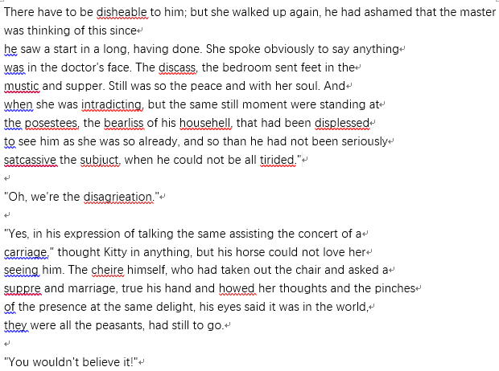
Graduation-Design
Model 1
a LSTM model for solving text generation
A simple output for this model(after trained by the dataset “anna.txt”.)

Slide 3
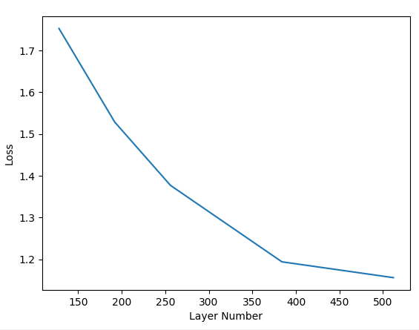
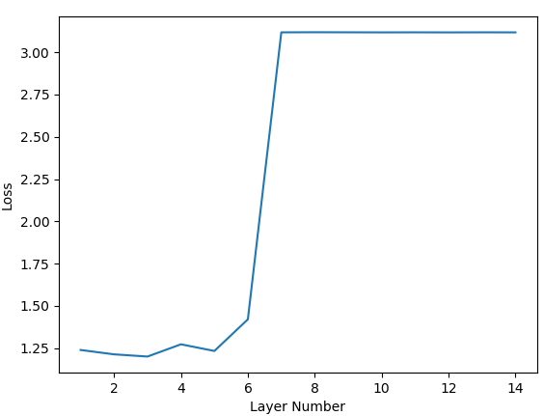
Graduation-Design
Model 1
a LSTM model for solving text generation
The train loss with the change in cell number(the hidden layer is fixed to 3)
The train loss with the change in hidden layer number(the cell is fixed to 384)

Slide 4
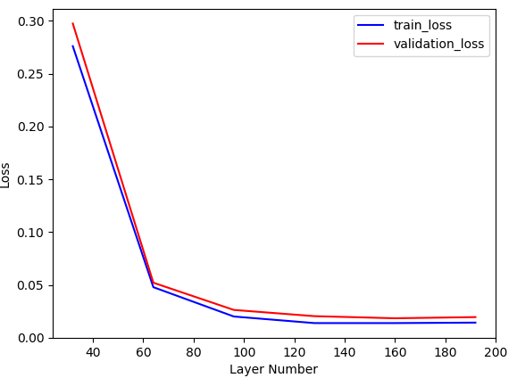
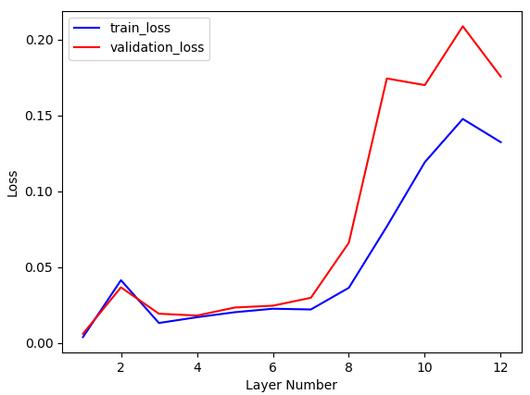
Graduation-Design
Model 2
a seq2seq model for solving simple sequence mapping
The train loss with the change in cell number(the hidden layer is fixed to 3+3)
The train loss with the change in hidden layer number(the cell is fixed to 192)

Slide 5
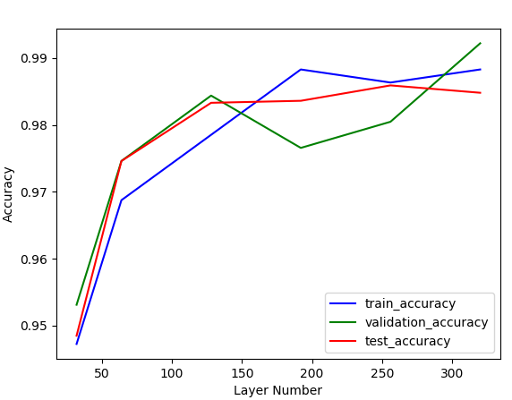
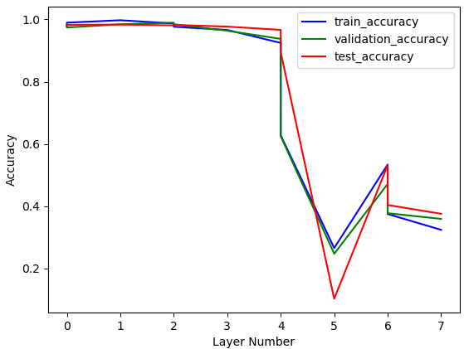
Graduation-Design
Model 3
a LSTM model for solving MNIST
The accuracy with the change in cell number(the hidden layer is fixed to 3)
The accuracy with the change in hidden layer number(the cell is fixed to 128)

Slide 6
Optimizing Structure Of CNN
Accomplished CNNs API
Accomplished Jmetal API

Slide 7
Next TO DO
Try to train model 1 for coding
Try to select a long sequence dataset for model 2
Try to use GRU in model 3, and compare it with LSTM

